Slide 1
Searching Algorithms
Lecture slides by:
Dr.Inayat-ur-Rehman

Slide 2
What is Searching
Finding the location of the record with a given key value, or finding the locations of some or all records which satisfy one or more conditions.
Search algorithms start with a target value and employ some strategy to visit the elements looking for a match.
  If target is found, the index of the matching element becomes the return value.

Slide 3
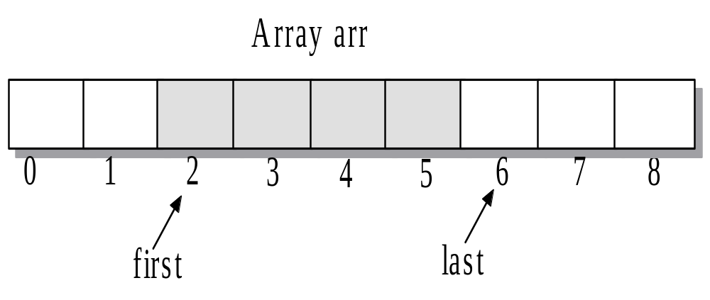
Searching

Slide 4
Searching Algorithms
There are primarily two main searching algorithms. They are as follows:
Linear Search
Binary Search

Slide 5
Linear Search
Search an array or list by checking items one at a time. The linear search is also known as sequential search.
Every element in the data set is examined in the order presented until the value being searched for is found. If the value being searched for does not exist, a flag value is returned.

Slide 6
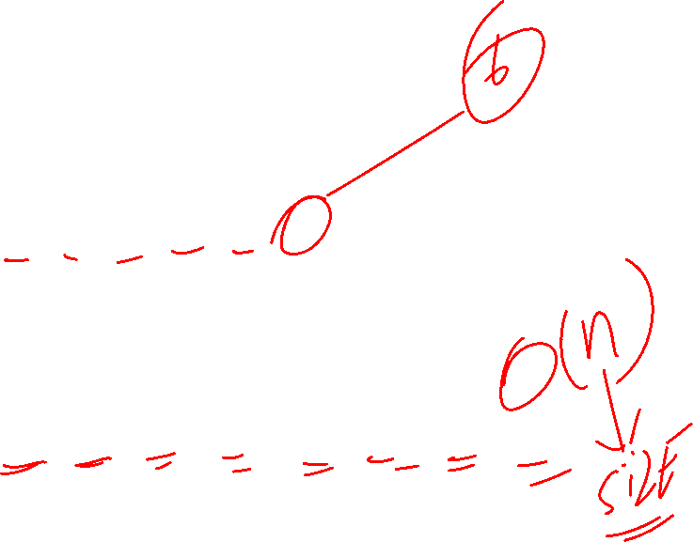
Linear Search
index =
seqSearch
(
arr
, 1, 8, 3);
target = 3
Index
1
2
3
4
5
6
7
8
6
4
2
9
5
3
10
7
match at index = 6
return index 6
index =
seqSearch
(
arr
1, 8,11);
target =11
Index
1
2
3
4
5
6
7
8
6
4
2
9
5
3
10
7
no match
return index 0

Slide 7

Properties – Linear Search
It is easy to implement.
It can be applied on random as well as sorted arrays.
It has more number of comparisons.
It is better for small inputs not for long inputs.

Slide 8

Linear Search Algorithm
Input: An Array A with n elements and the particular element X to be found
Output: Element X exists or NOT.
For i:=1 to n
IF (A[i]=X) THEN
Print: Item Exists
End Algorithm
Print: Item does not exist in Array
EXIT

Slide 9
Int search(arr, I, key){
if(i==size)
Return -1;
Else if(arr[i]==key)
Return i;
Else search(arr, i++);

Slide 10



Linear search Tracing
Lets search for the number 3. We start at the beginning and check the first element in the array. Is it 3?
No, not it. Is it the next element?
Not there either. The next element?

Slide 11


Linear search Tracing
Not there either. Next?
We found it!!! Now you understand the idea of linear searching;
we go through each element, in order, until we find the correct value or we don’t till the very end.

Slide 12
Linear Search
Consider a membership file in which each record contains, among other data the name and telephone number of its member. Suppose we are given the name of a member and we want to find his or her telephone number. One way to do this is to linearly search through the file, that is, apply the Linear Search:
Search each record of the file, one at a time, until finding the given Name and hence the corresponding telephone number

Slide 13
Linear Search
First of all, it is clear that the time required to execute the algorithm is proportional to the number of comparisons. Also, assuming that each name in the file is equally likely to be picked, it is intuitively clear that the average number of comparisons for a file with n records is equal to n/2; that is, the complexity of the linear search algorithm is given by O(n) for average case.

Slide 14
Linear Search
The Linear Search algorithm would be impossible in practice if we were searching through a list consisting of thousands of names, as in a telephone book. However, if the names are sorted alphabetically, as in telephone books, then we can use an efficient algorithm called binary search. The idea is discussed in the following slide.

Slide 15
Binary Search
Take a sorted array A to find an element x, 1st x is compared with middle element, if two are equal search is successful, if the two are not equal comparing the value of x with middle element narrows the either to the lower sub array or upper sub array. The search continues by repeating same process over and over on successively smaller sub arrays. Process terminates either when a match occurs or when search is narrowed down to a sub array which contains no elements.

Slide 16
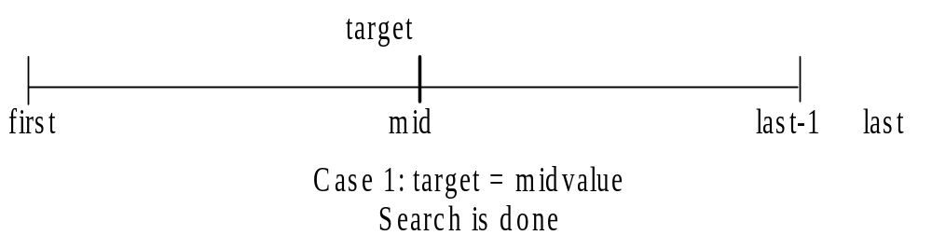
Binary Search Algorithm
Case 1
A match occurs. The search is complete and mid is the index that locates the target.
  if (midValue = target) Then Match Found
  End Algorithm

Slide 17
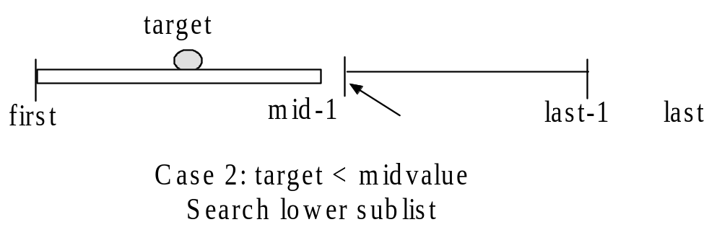
Binary Search Algorithm
Case 2.
The value of target is less than midvalue and the search must continue in the lower sublist. Reposition the index last to the end of the sublist (last = mid).
If (target < midvalue) THEN reposition last to mid search sublist arr[first]…arr[mid-1]

Slide 18
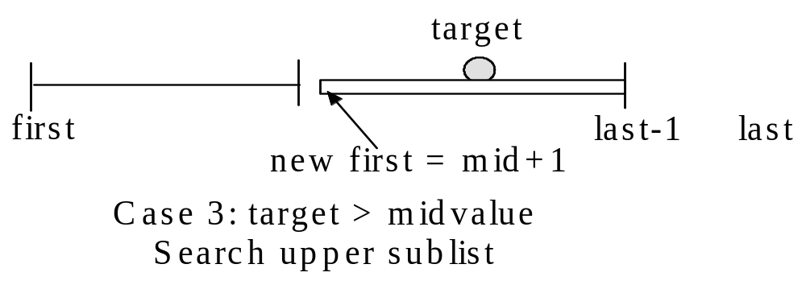
Binary Search Algorithm
Case 3.
The value of target is greater than midvalue and the search must continue in the upper sublist . Reposition the index first to the front of the sublist (first = mid+1).
// search upper sublist
if (target > midvalue)
<reposition first to mid+1>
<search sublist arr[mid+1]…arr[last-1]>

Slide 19
Binary Search Algorithm
Input: A sorted Array A and the element ITEM to be found
Output: The existence or otherwise of the element under consideration.
BEG := LB END :=UB
MID := INT ((BEG + END)/2) > use floor function
WHILE (BEG<=END) AND (DATA [MID]≠ ITEM)
IF ITEM < DATA[MID]
END:= MID-1
ELSE
BEG :=MID +1
MID:=INT((BEG+END)/2)
END-WHILE

Slide 20
Binary Search Algorithm
IF (DATA [MID]=ITEM) THEN
LOC:=MID
ELSE
LOC:=NULL
END IF
END Algorithm

Slide 21
Binary Search Tracing
1. Search for target = 23
Step 1: Indices Beg = 0,End = 8, mid = (0+8)/2 = 4.
0
1
2
3
4
5
6
7
8
9
arr
-7
3
5
8
12
16
23
33
55
mid
Since target = 23 > midvalue = 12, step 2 searches the upper sublist with Beg = 5 and End = 8.

Slide 22
Binary Search Tracing
Step 2:
Indices Beg = 5, End = 8, mid = (5+8)/2 = 6
0
1
2
3
4
5
6
7
8
arr
-7
3
5
8
12
16
23
33
55
mid
Since target = midvalue = 23, a match is found at index mid = 6.

Slide 23
Binary Search Tracing
Search for target = 4.
Step 1: Indices Beg = 0,End= 8, mid = (0+8)/2 = 4.
0
1
2
3
4
5
6
7
8
arr
-7
3
5
8
12
16
23
33
55
mid
Since target = 4 < midvalue = 12, step 2 searches the lower sublist with Beg = 0 and End = 3

Slide 24
Binary Search Tracing
Step 2: Indices Beg = 0,End = 3,
mid = (0+3)/2 = 1.
0
1
2
3
4
5
6
7
8
arr
-7
3
5
8
12
16
23
33
55
mid
Since target = 4 > midvalue = 3, step 3 searches the lower sublist with Beg = 2 and End =3.

Slide 25

Binary Search Tracing
Step 3: Indices Beg= 2, End= 3,
mid = (2+3)/2 = 2.
0
1
2
3
4
5
6
7
8
arr
-7
3
5
8
12
16
23
33
55
mid
Since target = 4 < midvalue = 5, step 4 should search the upper sublist with Beg = 2 and End=1. However, since Beg >= End,the target is not in the list and we return index last = Null.

Slide 26
Binary Search Tracing
Step 4: 4 is smaller than 5, so change End and move it to mid-1
End = 2-1 = 1
0
1
2
3
4
5
6
7
8
arr
-7
3
5
8
12
16
23
33
55
End
Beg
mid
Now the End is smaller than Beg, so in that case value doesn’t exist.

Slide 27
int R_bs(int *array,int size,int key){
static int lb=0,ub=size-1,mid=(lb+ub)/2;
if(ub==lb) {
return mid;
}
else if(array[mid]==key)
{ return mid;
}
else if(array[mid]<key)
{
lb=mid+1;
ub=size-1;
mid=(lb+ub)/2;
return R_bs(array,(lb+ub),key);
}
else if(array[mid]>key)
{
lb=0;
ub=mid-1;
mid=(lb+ub)/2;
return R_bs(array,(lb+ub),key);
}}

Slide 28
index
0
1
2
3
4
5
6
7
8
9
10
11
12
13
14
value
6
13
14
25
33
43
51
53
64
72
84
93
95
96
97

Slide 29
left
right
index
0
1
2
3
4
5
6
7
8
9
10
11
12
13
14
value
6
13
14
25
33
43
51
53
64
72
84
93
95
96
97
if Key v is in array, it is has index between left and right.

Slide 30
left
mid
right
index
0
1
2
3
4
5
6
7
8
9
10
11
12
13
14
value
6
13
14
25
33
43
51
53
64
72
84
93
95
96
97
Compute midpoint and check if matching Key is in that position.

Slide 31
left
mid
right
index
0
1
2
3
4
5
6
7
8
9
10
11
12
13
14
value
6
13
14
25
33
43
51
53
64
72
84
93
95
96
97
Since 33 < 53, can reduce search interval.

Slide 32
left
right
index
0
1
2
3
4
5
6
7
8
9
10
11
12
13
14
value
6
13
14
25
33
43
51
53
64
72
84
93
95
96
97
Since 33 < 53, can reduce search interval.

Slide 33
left
mid
right
index
0
1
2
3
4
5
6
7
8
9
10
11
12
13
14
value
6
13
14
25
33
43
51
53
64
72
84
93
95
96
97
Compute midpoint and check if matching Key is in that position.

Slide 34
left
mid
right
index
0
1
2
3
4
5
6
7
8
9
10
11
12
13
14
value
6
13
14
25
33
43
51
53
64
72
84
93
95
96
97
Since 33 > 25, can reduce search interval.

Slide 35
left
right
index
0
1
2
3
4
5
6
7
8
9
10
11
12
13
14
value
6
13
14
25
33
43
51
53
64
72
84
93
95
96
97
Since 33 > 25, can reduce search interval.

Slide 36
left
right
index
0
1
2
3
4
5
6
7
8
9
10
11
12
13
14
value
6
13
14
25
33
43
51
53
64
72
84
93
95
96
97
mid

Slide 37
left
index
0
1
2
3
4
5
6
7
8
9
10
11
12
13
14
value
6
13
14
25
33
43
51
53
64
72
84
93
95
96
97
right
Compute midpoint and check if matching Key is in that position.

Slide 38
left
index
0
1
2
3
4
5
6
7
8
9
10
11
12
13
14
value
6
13
14
25
33
43
51
53
64
72
84
93
95
96
97
right
Matching Key found. Return database index 4.

